Slide 1

CHAPTER 5
SEQUENCES,
MATHEMATICAL
INDUCTION, AND
RECURSION
Copyright © Cengage Learning. All rights reserved.

Slide 2
SECTION 5.3
Mathematical Induction II
Copyright © Cengage Learning. All rights reserved.

Slide 3
Mathematical Induction II
In natural science courses, deduction and induction are presented as alternative modes of thought—deduction being to infer a conclusion from general principles using the laws of logical reasoning, and induction being to enunciate a general principle after observing it to hold in a large number of specific instances.
In this sense, then, mathematical induction is not inductive but deductive.
Once proved by mathematical induction, a theorem is known just as certainly as if it were proved by any other mathematical method.

Slide 4
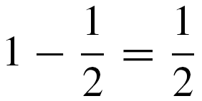
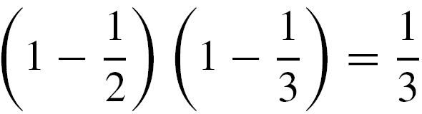
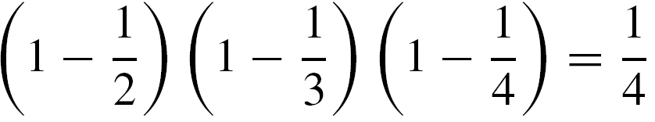
Mathematical Induction II
Inductive reasoning, in the natural sciences sense, is used in mathematics, but only to make conjectures, not to prove them.
For example, observe that

Slide 5
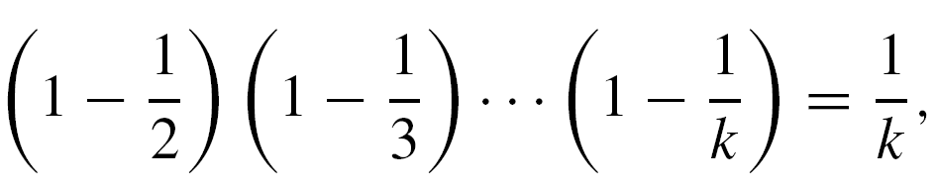
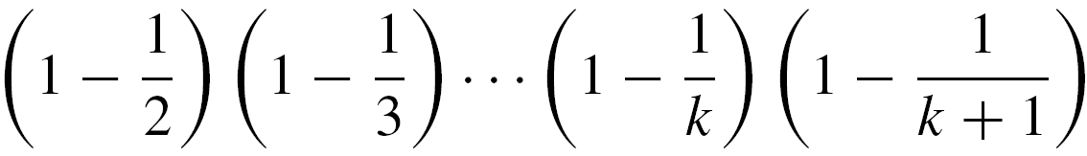
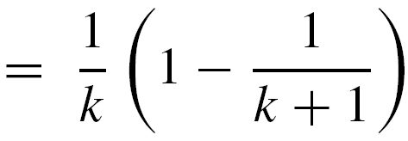
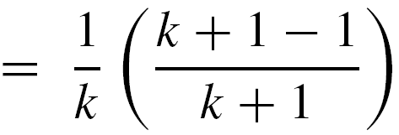
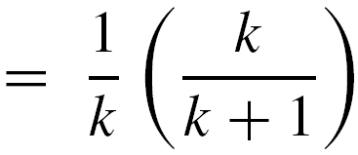
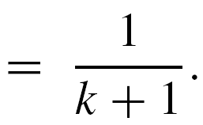
Mathematical Induction II
then by substitution
Thus mathematical induction makes knowledge of the general pattern a matter of mathematical certainty rather than vague conjecture.

Slide 6
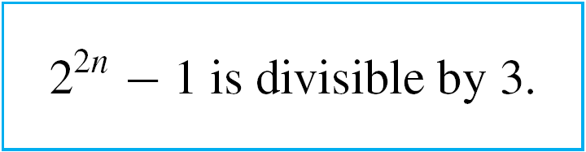

Example 1 – Proving a Divisibility Property
Use mathematical induction to prove that for all integers
n ≥ 0, 2^{2n} – 1 is divisible by 3.
Solution:
As in the previous proofs by mathematical induction, you need to identify the property P(n).
In this example, P(n) is the sentence

Slide 7
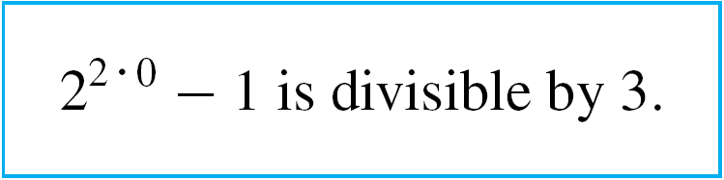

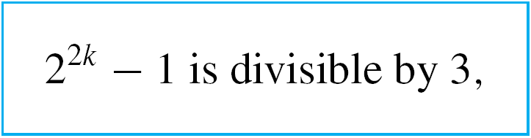
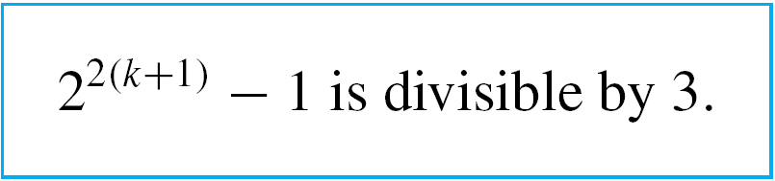

Example 1 – Solution
cont’d
By substitution, the statement for the basis step, P(0), is
The supposition for the inductive step, P(k), is
and the conclusion to be shown, P(k + 1), is

Slide 8
Example 1 – Solution
cont’d
We know that an integer m is divisible by 3 if, and only if,
m = 3r for some integer r.
Now the statement P(0) is true because
2^{2  0} – 1 = 2⁰ – 1 = 1 – 1 = 0, which is divisible by 3 because 0 = 3  0.
To prove the inductive step, you suppose that k is any integer greater than or equal to 0 such that P(k) is true.
This means that 2^{2k} – 1 is divisible by 3. You must then prove the truth of P(k + 1). Or, in other words, you must show that 2^{2(k+1)} – 1 is divisible by 3.

Slide 9




Example 1 – Solution
cont’d
But
The aim is to show that this quantity, 2^{2k}  4 – 1, is divisible by 3. Why should that be so? By the inductive hypothesis,
2^{2k} – 1 is divisible by 3, and 2^{2k}  4 – 1 resembles 2^{2k} – 1.

Slide 10
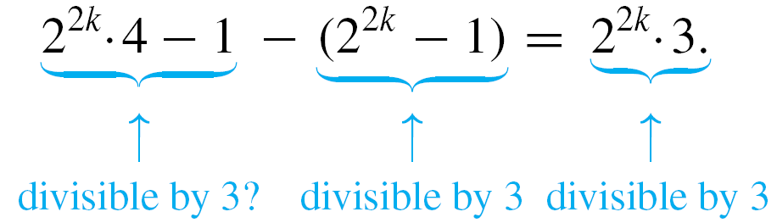
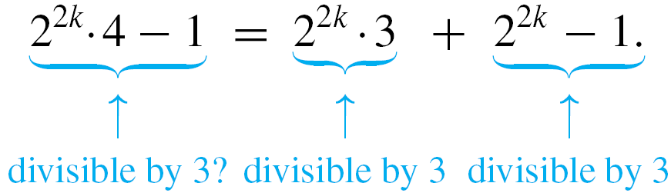
Example 1 – Solution
cont’d
Observe what happens, if you subtract 2^{2k} – 1 from 2^{2k}  4 – 1:
Adding 2^{2k} – 1 to both sides gives
Both terms of the sum on the right-hand side of this equation are divisible by 3; hence the sum is divisible by 3.

Slide 11

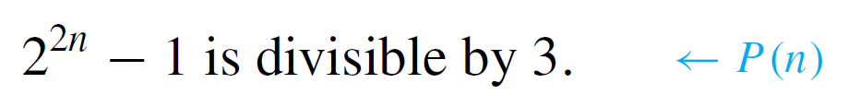
Example 1 – Solution
cont’d
Therefore, the left-hand side of the equation is also divisible by 3, which is what was to be shown.
This discussion is summarized as follows:
Proof (by mathematical induction):
Let the property P(n) be the sentence “2^{2n} – 1 is divisible by 3.”

Slide 12
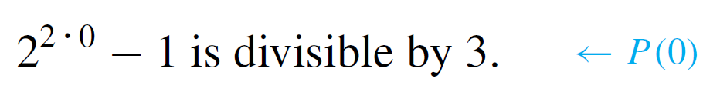

Example 1 – Solution
cont’d
Show that P(0) is true:
To establish P(0), we must show that
But
and 0 is divisible by 3 because 0 = 3  0.
Hence P(0) is true.

Slide 13
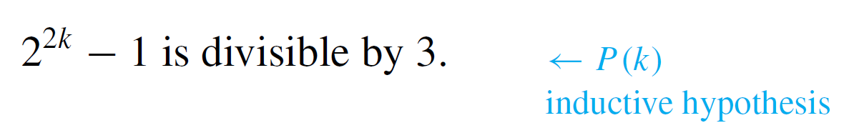
Example 1 – Solution
cont’d
Show that for all integers k ≥ 0, if P(k) is true then
P(k + 1) is also true:
[Suppose that P(k) is true for a particular but arbitrarily chosen integer k ≥ 0. That is:]
Let k be any integer with k ≥ 0, and suppose that
By definition of divisibility, this means that

Slide 14







Example 1 – Solution
cont’d
[We must show that P(k + 1) is true. That is:] We must show that
But

Slide 15







Example 1 – Solution
cont’d
But is an integer because it is a sum of products of integers, and so, by definition of divisibility, is divisible by 3 [as was to be shown].
[Since we have proved the basis step and the inductive step, we conclude that the proposition is true.]

Slide 16
Mathematical Induction II
The next example illustrates the use of mathematical induction to prove an inequality.

Slide 17

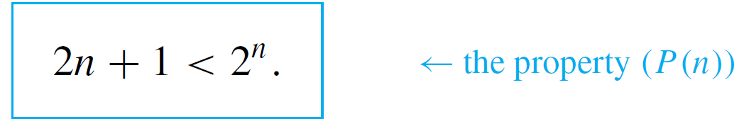
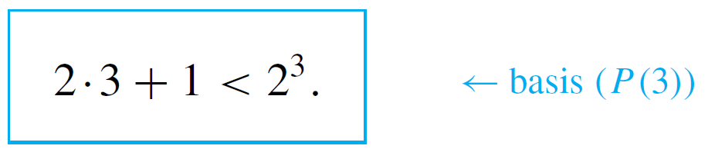
Example 2 – Proving an Inequality
Use mathematical induction to prove that for all integers
n ≥ 3,
Solution:
In this example the property P(n) is the inequality
By substitution, the statement for the basis step, P(3), is

Slide 18
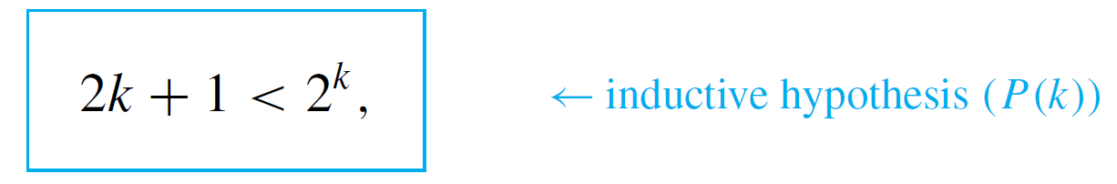
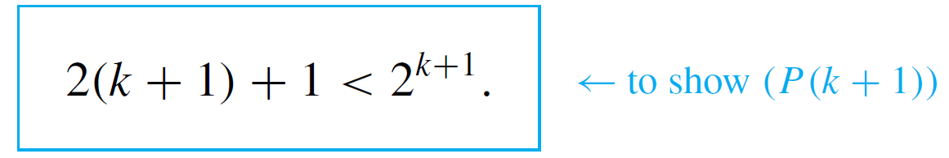
Example 2 – Solution
cont’d
The supposition for the inductive step, P(k), is
and the conclusion to be shown is
To prove the basis step, observe that the statement P(3) is true because 2  3 + 1 = 7, 2³ = 8, and 7 < 8.

Slide 19

Example 2 – Solution
cont’d
To prove the inductive step, suppose the inductive hypothesis, that P(k) is true for an integer k ≥ 3.
This means that 2k + 1 < 2^{k} is assumed to be true for a particular but arbitrarily chosen integer k ≥ 3.
Then derive the truth of P(k + 1). Or, in other words, show that the inequality is true. But by multiplying out and regrouping,
and by substitution from the inductive hypothesis,

Slide 20

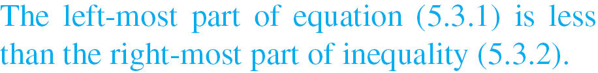
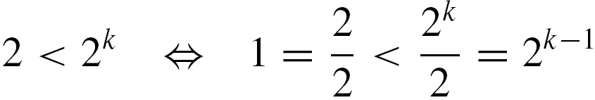

Example 2 – Solution
cont’d
Hence
If it can be shown that 2^{k} + 2 is less than 2^{k+1}, then the desired inequality will have been proved.
But since the quantity 2^{k} can be added to or subtracted from an inequality without changing its direction,
And since multiplying or dividing an inequality by 2 does not change its direction,

Slide 21




Example 2 – Solution
cont’d
This last inequality is clearly true for all k ≥ 2. Hence it is true that .
This discussion is made more flowing (but less intuitive) in the following formal proof:
Proof (by mathematical induction):
Let the property P(n) be the inequality

Slide 22


Example 2 – Solution
cont’d
Show that P(3) is true:
To establish P(3), we must show that
But
Hence P(3) is true.

Slide 23

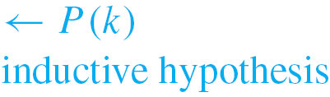

Example 2 – Solution
cont’d
Show that for all integers k ≥ 3, if P(k) is true then
P(k + 1) is also true:
[Suppose that P(k) is true for a particular but arbitrarily chosen integer k ≥ 3. That is:]
Suppose that k is any integer with k ≥ 3 such that
[We must show that P(k + 1) is true. That is:] We must show that

Slide 24





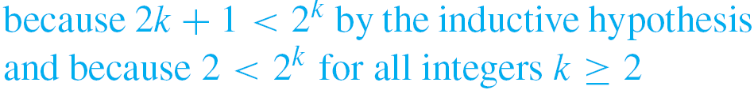


Example 2 – Solution
cont’d
Or, equivalently,
But
[This is what we needed to show.]
[Since we have proved the basis step and the inductive step, we conclude that the proposition is true.]

Slide 25
A Problem with Trominoes

Slide 26
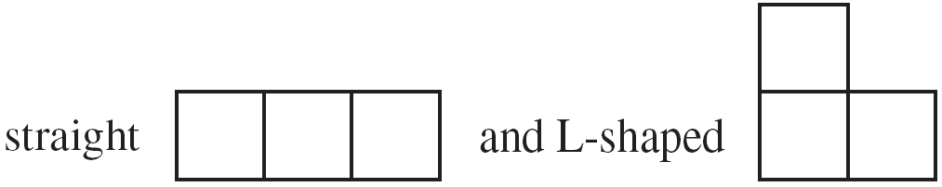
A Problem with Trominoes
A particular type of polyomino, called a tromino, is made up of three attached squares, which can be of two types:
Call a checkerboard that is formed using m squares on a side an m × m (“m by m”) checkerboard.
Observe that if one square is removed from a 4 × 4 checkerboard, the remaining squares can be completely covered by L-shaped trominoes.

Slide 27
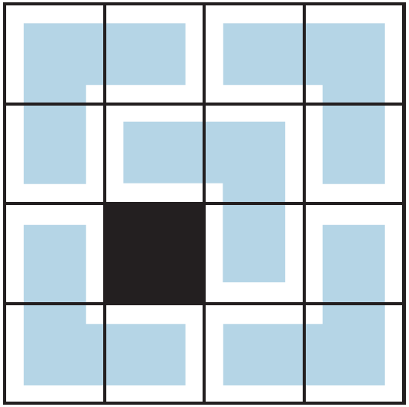
A Problem with Trominoes
For instance, a covering for one such board is illustrated in the figure below.
It is a beautiful example of an argument by mathematical induction.

Slide 28
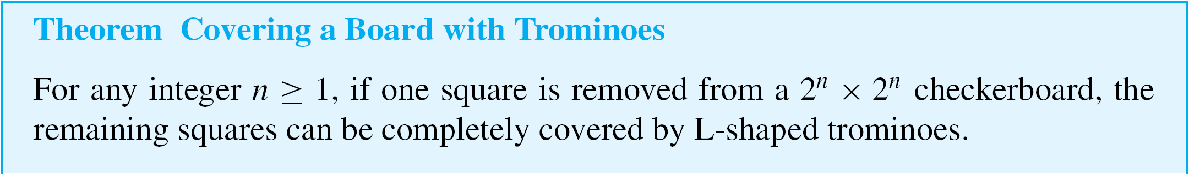



A Problem with Trominoes
The main insight leading to a proof of this theorem is the observation that because , when a board is split in half both vertically and horizontally, each half side will have length 2^{k} and so each resulting quadrant will be a checkerboard.

Slide 29


A Problem with Trominoes
Proof (by mathematical induction):
Let the property P(n) be the sentence
If any square is removed from a 2^{n} × 2^{n} checkerboard,
then the remaining squares can be completely
covered by L-shaped trominoes.
Show that P(1) is true:
A 2¹ × 2¹ checkerboard just consists of
four squares. If one square is removed,
the remaining squares form an L, which
can be covered by a single L-shaped
tromino, as illustrated in the figure to the
right. Hence P(1) is true.

Slide 30

A Problem with Trominoes
Show that for all integers k ≥ 1, if P(k) is true then P(k + 1) is also true:
[Suppose that P(k) is true for a particular but arbitrarily chosen integer k ≥ 3. That is:]
Let k be any integer such that k ≥ 1, and suppose that
If any square is removed from a 2^{k} × 2^{k} checkerboard,
then the remaining squares can be completely
covered by L-shaped trominoes.

Slide 31

A Problem with Trominoes
P(k) is the inductive hypothesis.
[We must show that P(k + 1) is true. That is:] We must show that
If any square is removed from a 2^{k+1} × 2^{k+1} checkerboard, then the remaining squares can be completely
covered by L-shaped trominoes.

Slide 32
A Problem with Trominoes
Consider a 2^{k+1} × 2^{k+1} checkerboard with one square removed. Divide it into four equal quadrants: Each will consist of a 2^{k} × 2^{k} checkerboard.
In one of the quadrants, one square will have been removed, and so, by inductive hypothesis, all the remaining squares in this quadrant can be completely covered by
L-shaped trominoes.
The other three quadrants meet at the center of the checkerboard, and the center of the checkerboard serves as a corner of a square from each of those quadrants.

Slide 33
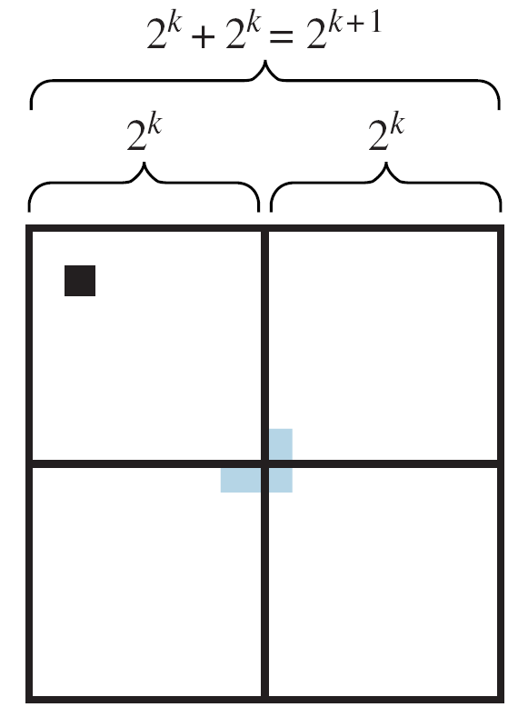
A Problem with Trominoes
An L-shaped tromino can, therefore, be
placed on those three central squares.
This situation is illustrated in the figure
to the right.
By inductive hypothesis, the remaining
squares in each of the three quadrants
can be completely covered by L-shaped trominoes.
Thus every square in the 2^{k+1} × 2^{k+1} checkerboard except the one that was removed can be completely covered by
L-shaped trominoes [as was to be shown].

